Slide 1


2Centz Application
Elton Ago

Slide 2





Application layout
Home Screen
S&P500 Companies
Create Account
Login to Account
Searched Asset
News
Projections

Slide 3

Introduction
“Nobody can predict the future. However, one thing is clear, it will be very different to today. We believe that a number of deeply-rooted forces - megatrends - are driving fundamental changes within the investment management industry”—KPMG

Slide 4

Call to action
“Building wealth through investing doesn't happen overnight, and the balances of each age group indicate that clearly. Starting to invest early helps immensely, even if you feel like you don't have much to show for it in the beginning. In investment accounts, compound interest — the process by which interest earns interest on itself, growing an investment account's balance quicker than it would otherwise — means that starting early helps to grow money quicker.”

Slide 5
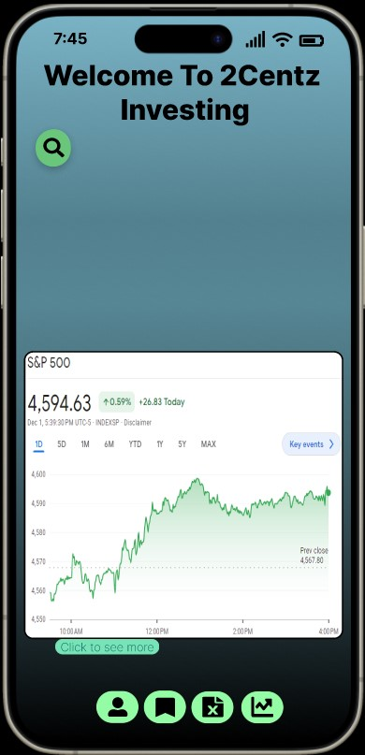
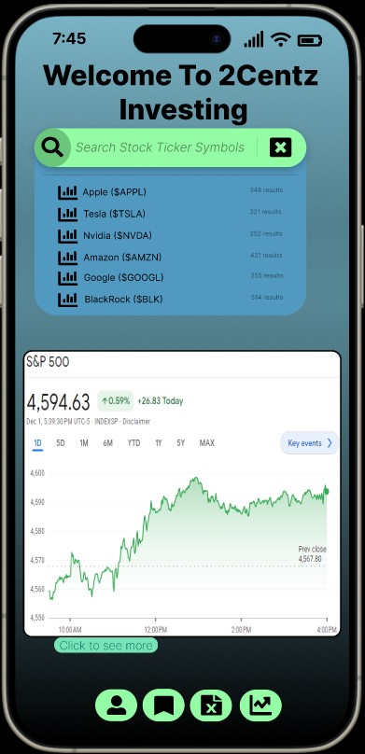

Home Screen

Slide 6
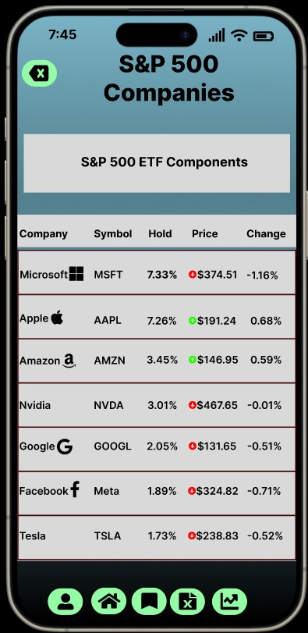
S&P 500 Screen

Slide 7
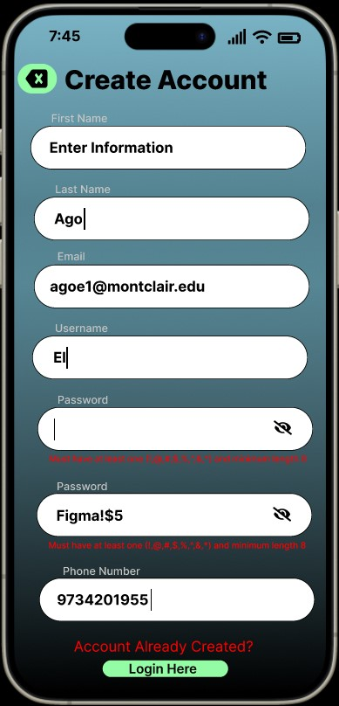
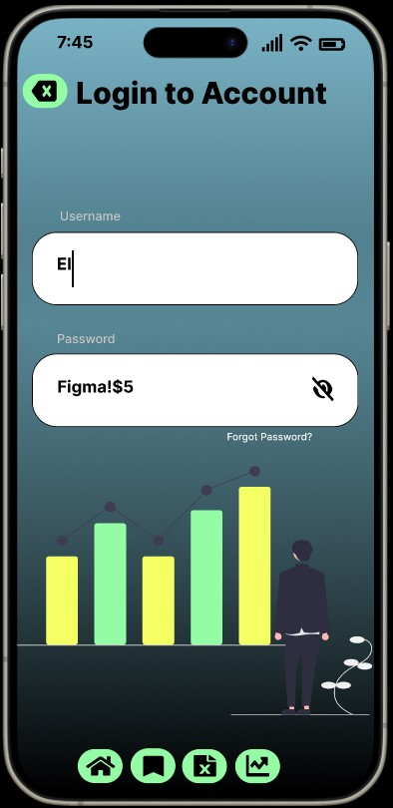
Create & Login Account Screen

Slide 8
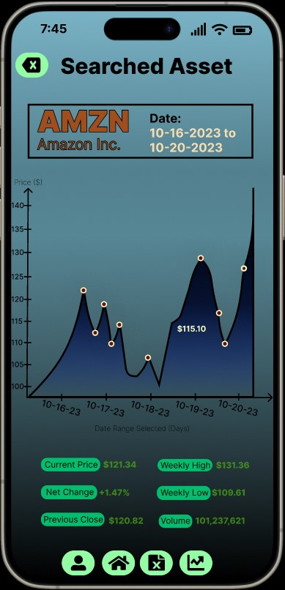
Searched Asset Screen

Slide 9
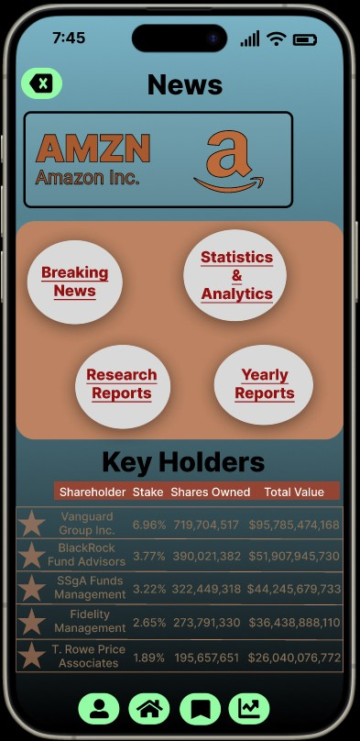
Searched Asset Screen
Yahoo Finance Quarterly, Earning, and Revenue Estimates
Yahoo Finance News Updates Real Time
Amazon Released Financial Reports (2022 Document)
Bloomberg Case Studies

Slide 10
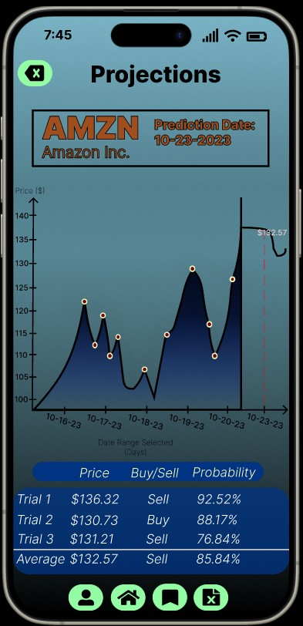
Prediction Screen

Slide 11




Thank you
Elton Ago
Human-Computer Interactions
Professor H. Zhou

